Slide 1
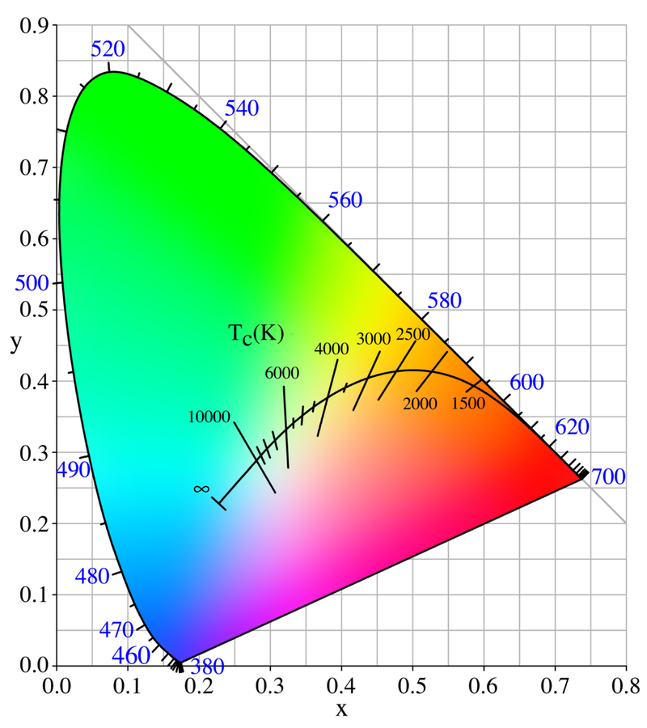

APPLIED PHYSICS 187
DR. MARICOR SORIANO
Activity 6
RENE L. PRINCIPE JR
2015-04622

Slide 2

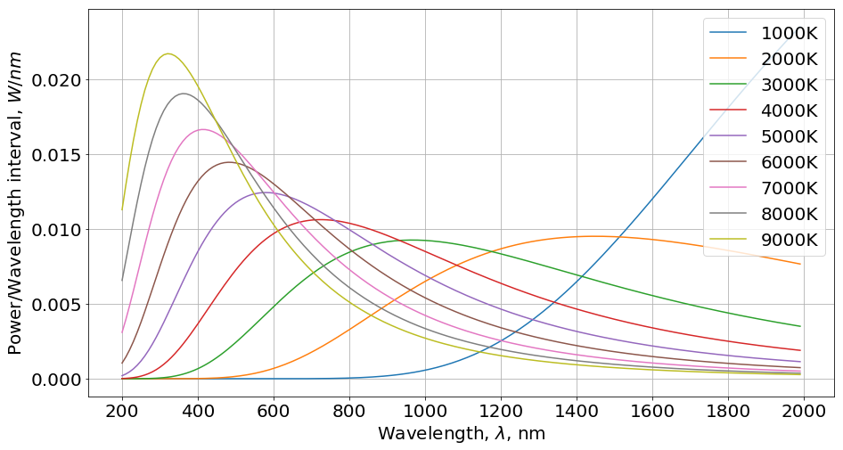
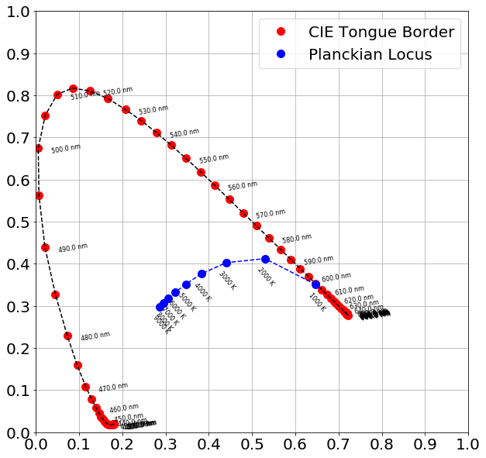
replication
02
Figure 1. Blackbody Spectrum at varying temperatures
In this activity, I aim to replicate the CIE Tongue Plot as well as the Planckian locus as shown in Fig. 2. For the borders of the tongue, I evaluated the xy coordinates of the border by assuming a driac delta emittance of discrete wavelengths of light (monochromatic light source). This was done for all the wavelengths in the visible range. For the Planckian Locus, we take the emittance spectrum to be the blackbody spectrum obtained using Planck’s equation. Again, the xy coordinates was derived by taking the areas under the curve of the spectrum multiplied to the color matching functions. After trasnforming the values to the Normalized Color Coordinates (NCC) space, we obtain the plot as shown in Fig. 3.
Figure 2. The CIE xy Tongue plot and the Planckian locus.
https://upload.wikimedia.org/wikipedia/commons/b/ba/PlanckianLocus.png
Figure 3. My replication of the CIE xy Tongue and the Planckian locus.

Slide 3
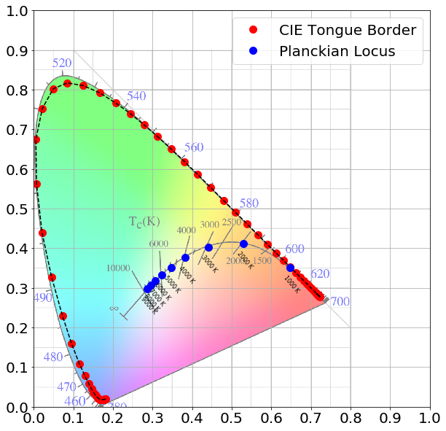
COMPARISON
03
Figure 4. Comparison of the CIE xy tongue plot and Planckian Locus superimposed with my own rendition.
I superimposed the reference photo with my rendition to check if I properly calculated the coordinates by aligning the gridlines, A slight misalignment is evident in Fig. 4. Nevertheless, the calculations in my code almost reconstructed the actual CIE xy Tongue and the Planckian locus.
Reference:
M. Soriano. Color Matching Functions (2019).

